Slide 1
Integrating Fee Planning Into Your Practice
Getting At Clients’ Values and Vision for the Future

Slide 2
WE START HERE
TODAY’S MEETING PLAN
CONTEXT
PROBLEM
ACTION
Every advisor talks about client goals and objectives but no one clarifies what they value or the vision they have for the future.
Only 50% of clients think their advisor is open to discussing what they value most in life.*
We’ll show you how to have these conversations so they aren’t scary and so they lead to strong engagements with clients.
*PRNEWSWIRE, February 2022. Research Reveals Major Shifts in Communication and Trust Between Financial Planners and Their Clients

Slide 3
Now that the prospect has agreed to the process and are a client, we begin…
THE
DISCOVERY
PROCESS

Slide 4
VALUES
VISION
GOALS
KEEPING THE PROMISE
These are discussions designed to help clients identify, prioritize,
and act on what is most important to them.

Slide 5
UNCOVERING CLIENT
VALUES

Slide 6
EVERYTHING
Everything we think, say and do is filtered through our values.
ALIGNMENT
When our actions are aligned with our values, we gain a sense of success and trust.
GOAL ACHIEVEMENT
We are Driven by
VALUES
Goals are more likely to be pursued and achieved when they’re aligned with our values.
PERMISSION
Knowing and acknowledging values creates permission for stronger conversations.
IMPROVE RESULTS
The purpose of understanding values is to improve the results for the client.

Slide 7
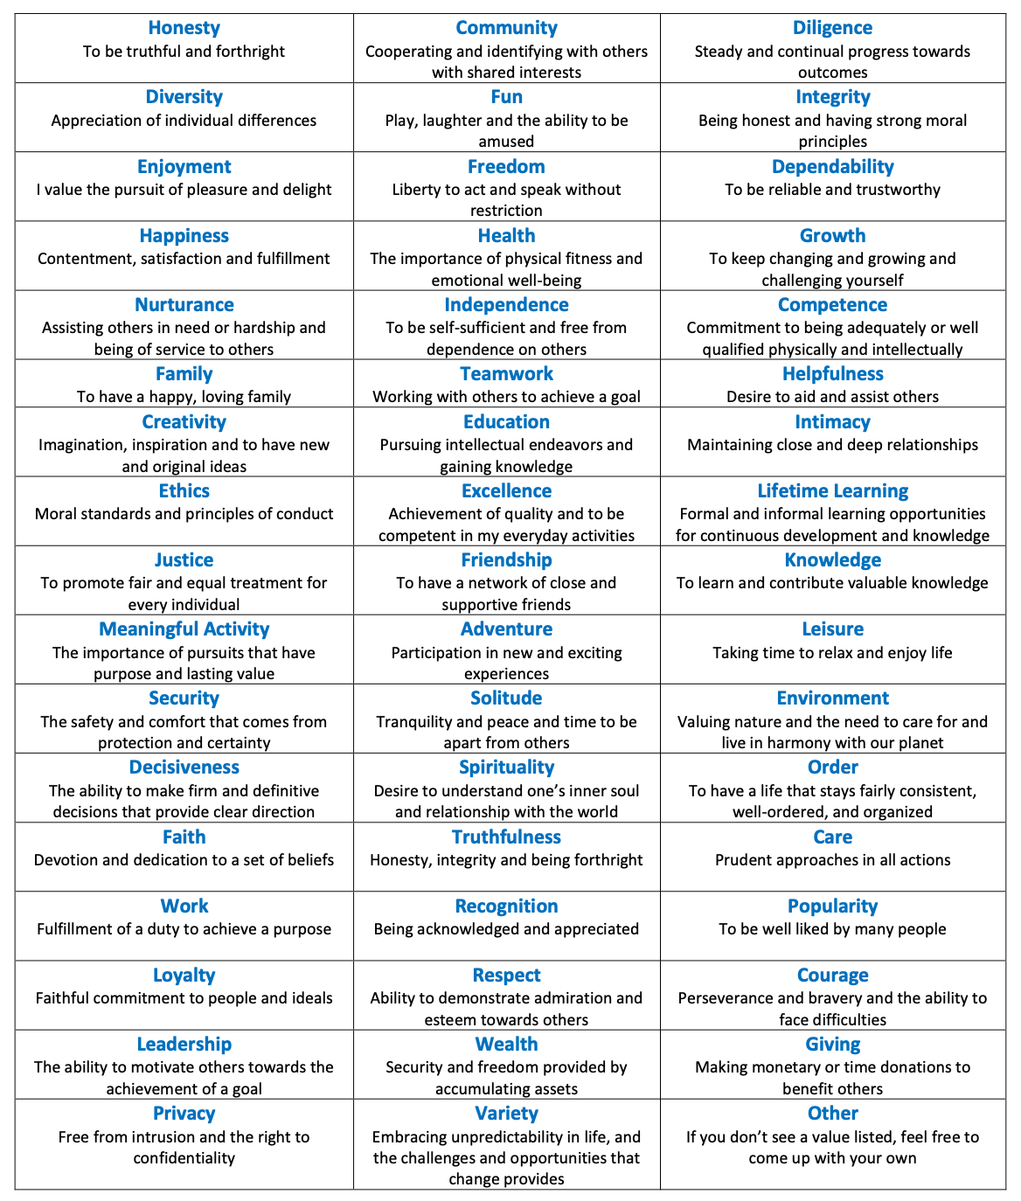

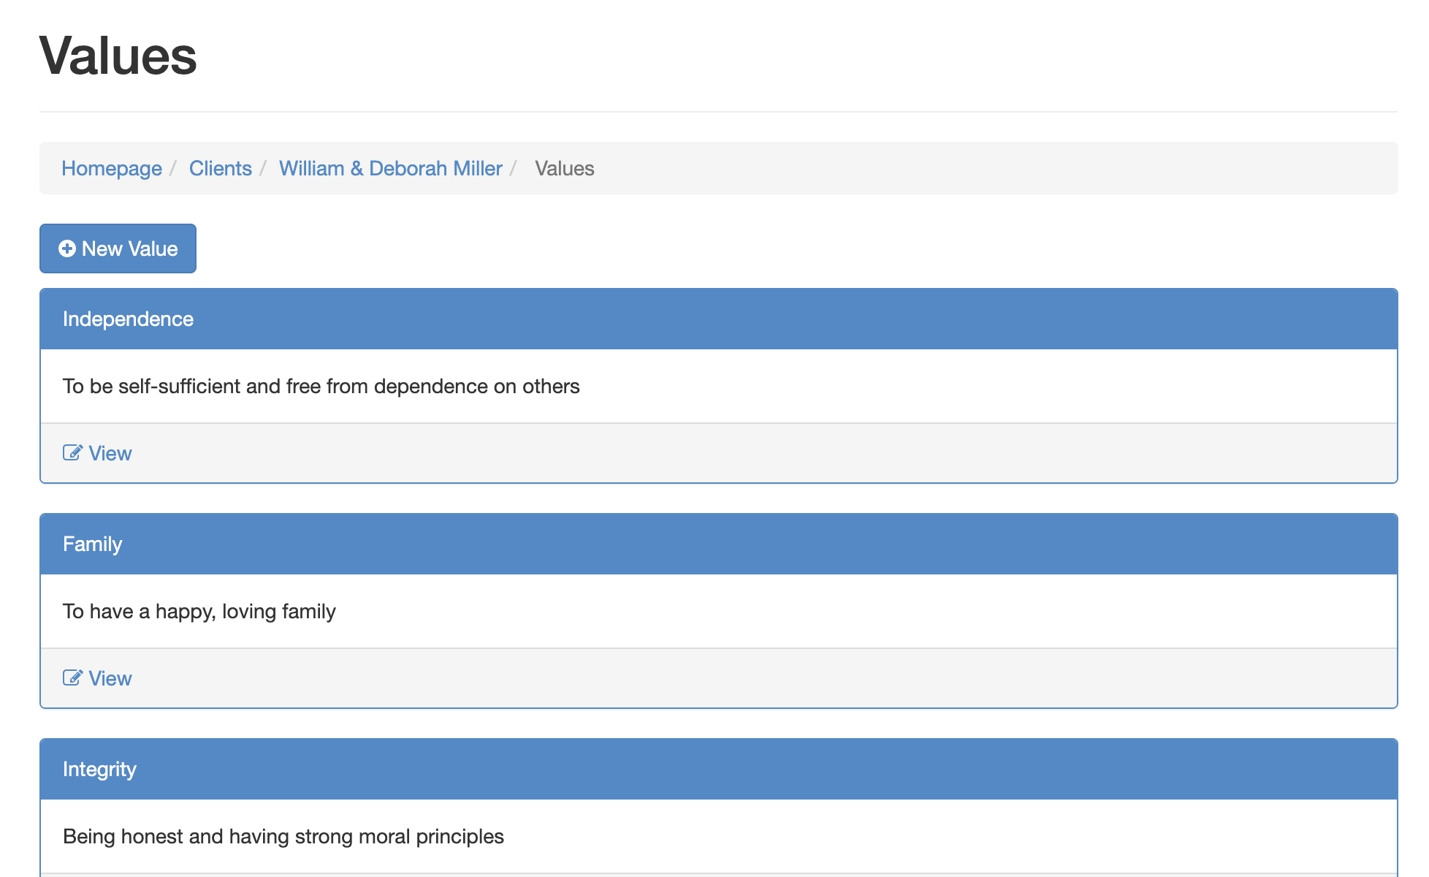
GETTING AT VALUES WITH
THREE TOOLS
The preferred method is using the Legacy Values Cards. However, the paper exercise and the app also work well.
Fillable Paper Exercise
Values Cards Exercise
Qualitate™ Software

Slide 8
THE METHOD
A clear purpose, safety, context and confirmation allow the Values Discovery Process to change the relationship permanently.
HOW TO
IDENTIFY
VALUES
REASSURE
PURPOSE
SAFETY
CONTEXT
CONFIRMATION
Most people simply haven’t sat down to get clear on their values, so if they don’t come to you quickly, don’t worry. We’re just doing a bit of exploring together.
We spoke about Values when we first met, and the point of us understanding it is:
To make sure we have a set of rules and standards that we can use when helping you make decisions about your future.
So we know what’s important to you and honor it.
We have a really simple exercise that will help guide you through the process and we can ask a few questions along the way.
Let’s look at the values cards and see which ones you connect with most. The goal is to refine the values to a workable number of about five (5).
How does this value serve you?
How could this value restrict or impair you?
How do you respond when this value is challenged or violated by others?
How could this create a blind spot for you?

Slide 9

CHECKING IN…
QUESTIONS?
What do you need to clarify or understand better?
Notes:
Words matter
Agenda is a loaded word
Plans are better
Use this with advisors

Slide 10
HOW TO ARTICULATE A
VISION

Slide 11
HERE IS THE KEY
WITHOUT VISION, THE PEOPLE PERISH
A compelling vision creates energy, creativity, momentum and drives decisions.

Slide 12
CRITICAL
SETTING THE STAGE
By setting the right parameters, you set yourself and your clients up for success.
10 YEARS OR MORE
TODAY
Removes the constraints of Time, Wealth and Knowledge
THE FUTURE
PROGRESSIVELY UNKNOWABLE
KNOWABLE
CRYSTAL CLEAR
Your ability to help your clients develop a crystal-clear picture of the future will help them plan and help them act.

Slide 13
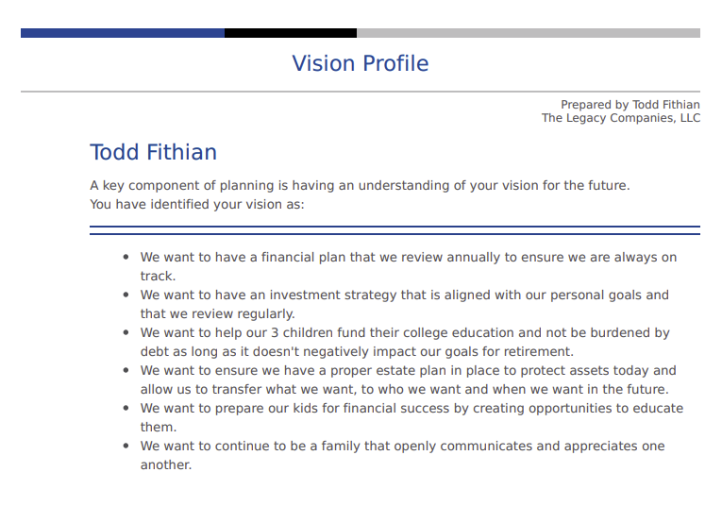
Sample Vision Profile for the Qualitate™ Application

Slide 14
THE METHOD
Helping clients articulate their desired future state by providing a clear purpose, safety, context and the right questions to unpack their vision.
HOW TO ARTICULATE A VISION
REASSURE
PURPOSE
SAFETY
CONTEXT
QUESTIONS
Most people haven’t sat down to get really clear on their vision, so rest easy if you don’t have quick answers here. We’re just doing a bit of exploring to figure it out together.
We spoke about Vision when we first met, and there are two reasons for getting clear on it:
To make sure we only address issues that are important to you; and
To make sure that what we suggest is going to matter in the long run, not just in the short term,
I just have a few questions to help me get a sense for how you want things to be in the future.
Let’s start by thinking out about 10 years into the future. We can’t know everything that will happen between now and then, but it’s enough time to make some real changes on things that matter to you.
Do you have a sense of what you want the future to look like for your [business, finances, retirement, family, etc.]? Can you tell me about it?
How would you know if you created a successful [life, business, succession, retirement, etc.]? Give me an example.
If you were guaranteed to succeed at [whatever], what would you do?
What are 5 things you want to be proud of in the future?
What is it that you want to [have, be, do]?
What will be happening in your life in 10 years? What won’t be happening?
V1.0

Slide 15

What did you learn? What questions do you have? What will you do next?
QUESTIONS?

Slide 16

WHAT’S
IMPORTANT
NEXT…
Next Call Topic: Goals
In advance of this call, please complete the following prep-work:
1. Login to the Members site and click on Courses. Complete Modules 7 and 8.
2. Go through the GISOR model to identify your clients top 3 prioritized goals. Be prepared to talk about how this evolved goal setting process highlights the emotional factors that move clients to action.
3. Be prepared to talk about the Goal Affirmation Process. This process is designed to put the clients top 3 prioritized goals back in front of them asking them to affirm whether they Agree, Disagree, or are unsure with each goal. This step will not only have you positioned as a different kind of advisor, but it will make sure you’re in perfect alignment with your client.
  Next Call: August 23 @ 4PM Eastern

