Slide 1
Integrating Fee Planning Into Your Practice
Evolving Your Sales Approach to Include Fee Planning

Slide 2
WE START HERE
TODAY’S MEETING PLAN
CONTENT
PROBLEM
ACTION
Advisors need a clear differentiator to stand out in a crowded marketplace.
Wealth holders are being inundated by lots of advisors. So how do you stand out?
By using The Planning Horizon® you can demonstrate your difference from the very first meeting.

Slide 3


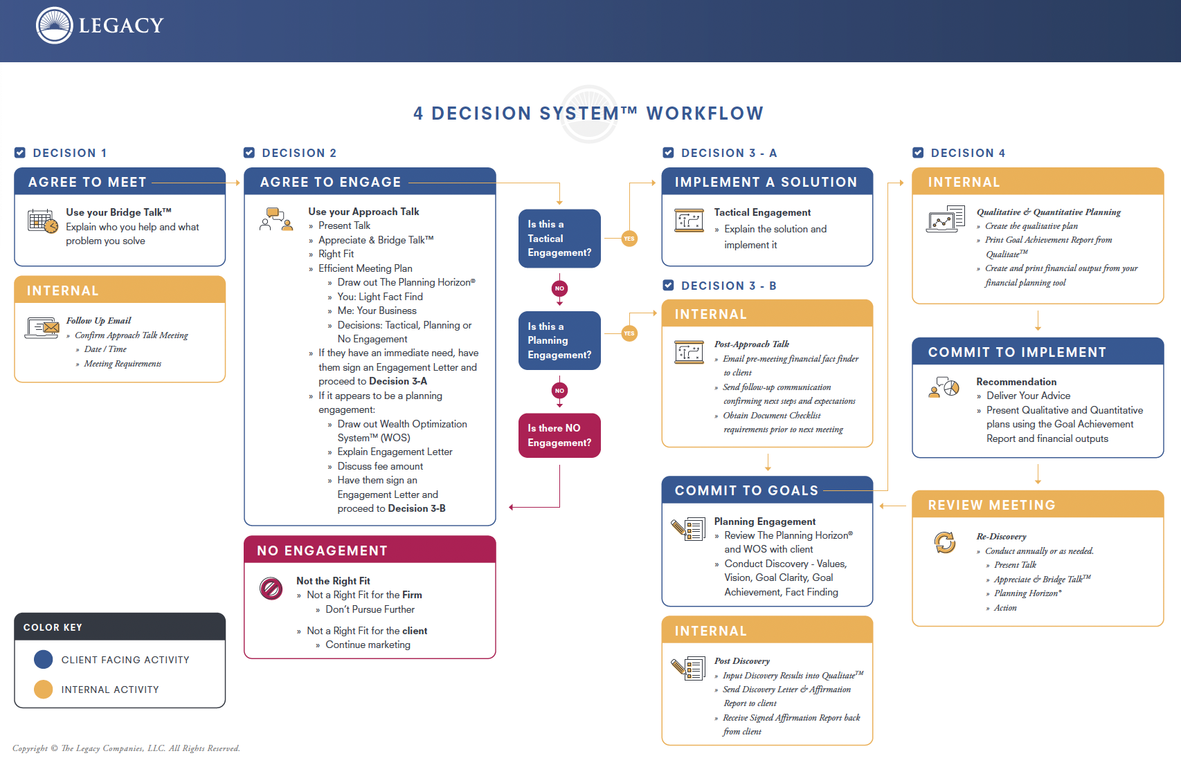
Three Key Resources
1: Sales Structure & Scripts
3: Facilitation Workbook
2: Process Workflow & Experience

Slide 4




TO THE POINT
BE PREPARED
STRUCTURE MATTERS
RAPID RECAP
Never ”wing it” with prospects
Build it to win engagements
THE PLANNING HORIZON®
& THE WEALTH OPTIMIZATION SYSYTEM™
PERFECT PRACTICE
So you don’t have to think about it
Your Definable Difference

Slide 5
STRUCTURE MATTERS
THE APPROACH TALK™ STRUCTURE
The design of this meeting sets the structure of the relationship, and the engagement.
5MIN
5MIN
30MIN
15MIN
5MIN
PRESENT TALK
APPRECIATE, & BRIDGE TALK™
YOU
ME
DECISIONS
Chit-chat that gets everyone present to the meeting at hand
This includes Appreciate, Bridge Talk™, Right Fit and Efficient Meeting Plan
Client interview and The Planning Horizon® conversation
Value, process, philosophy and team
Engagement decision – Tactical, Planning or None

Slide 6

DEMONSTRATE YOUR DEFINABLE DIFFERENCE
THE PLANNING HORIZON®
The cornerstone conversation that shifts the relationship.
VALUES, VISION & GOALS
WHAT matters most to you, and WHY it’s important.
ABOVE
BELOW
STRATEGIES, TACTICS & TOOLS
HOW, WHO and WHEN to solve it.

Slide 7
Wealth Optimization System™
VALUES, VISION & GOALS
WHAT matters most to you, and WHY it’s important.
CONFIDENCE
Results Management Leading to Confidence
4
1
CLARITY
Discovery Leading to Clarity
Sustain
The Result
Identify Values,
Vision & Goals
3
2
Implement
The Solution
Think About
The Solution
RESULTS
Strategy Deployment Leading to Results
DECISIONS
Creative Solutions Leading to Decisions
STRATEGIES, TACTICS & TOOLS
WHO, HOW and WHEN to solve it.
V1.0

Slide 8
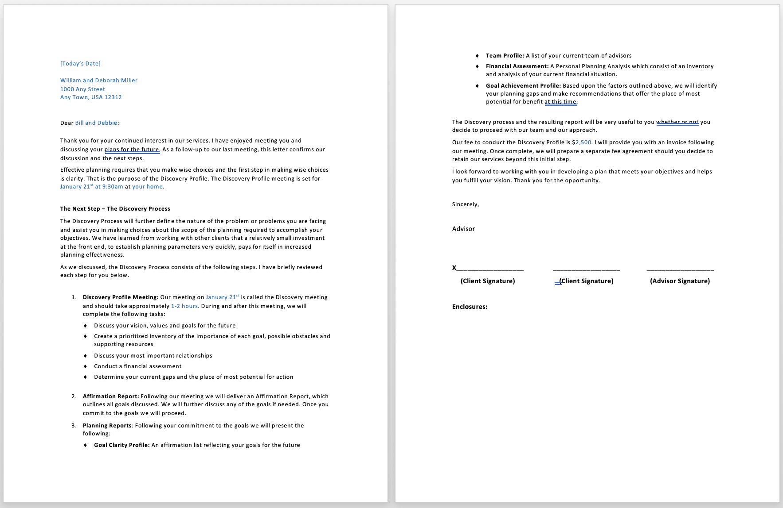
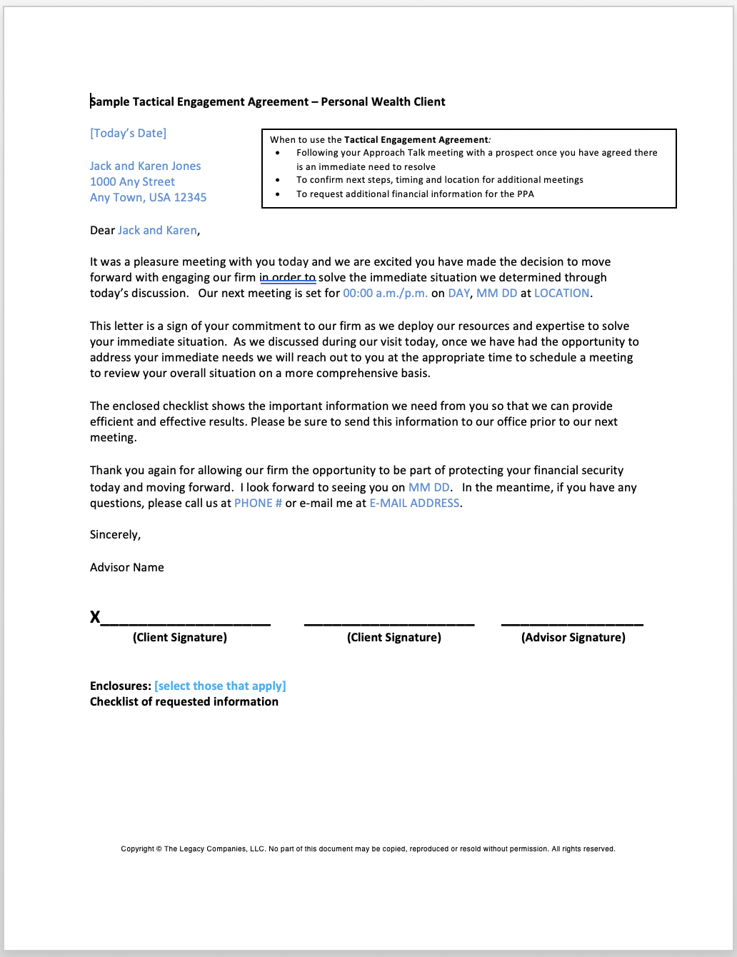
ENGAGEMENT AGREEMENTS
PLANNING
TACTICAL

Slide 9

CHECKING IN…
QUESTIONS?
What did you need to clarify or understand better?
Notes:
Words matter
Agenda is a loaded word
Plans are better
Use this with advisors

Slide 10

SHARE HOW YOU WILL
SHIFT/CHANGE YOUR
APPROACH LANGUAGE
FEEDBACK
One of you provides feedback based on the Approach Talk criteria
One of you play the role of the advisor and one the prospect
RUN YOUR APPROACH MEETING
REPEAT
Follow the Meeting Plan
Give everyone a chance to participate
Notes:
To change the image behind the Mock up.
Select the layer - > Right Click -> Send to Back -> Delete the image -> Drag & Drop your Own Picture -> Send to Back (again)

Slide 11

PERFECT PRACTICE
WHAT DID YOU LEARN?
Practice makes permanent. Perfect practice makes perfect.
What did you see that worked? What didn’t work? What did you learn? What will you do next?

Slide 12
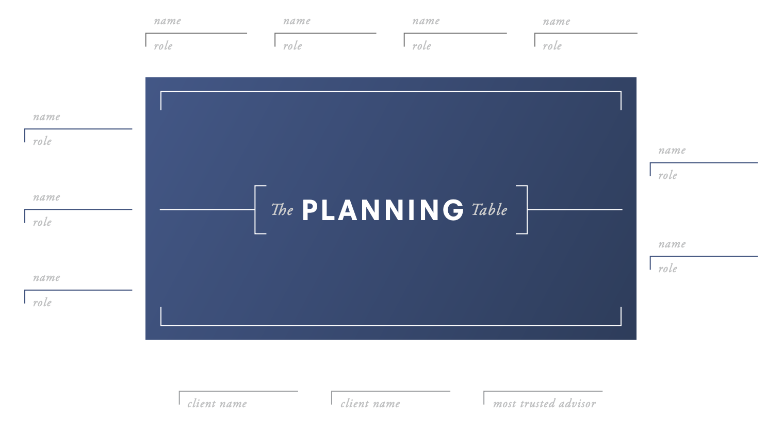
THE PLANNING TABLE

Slide 13
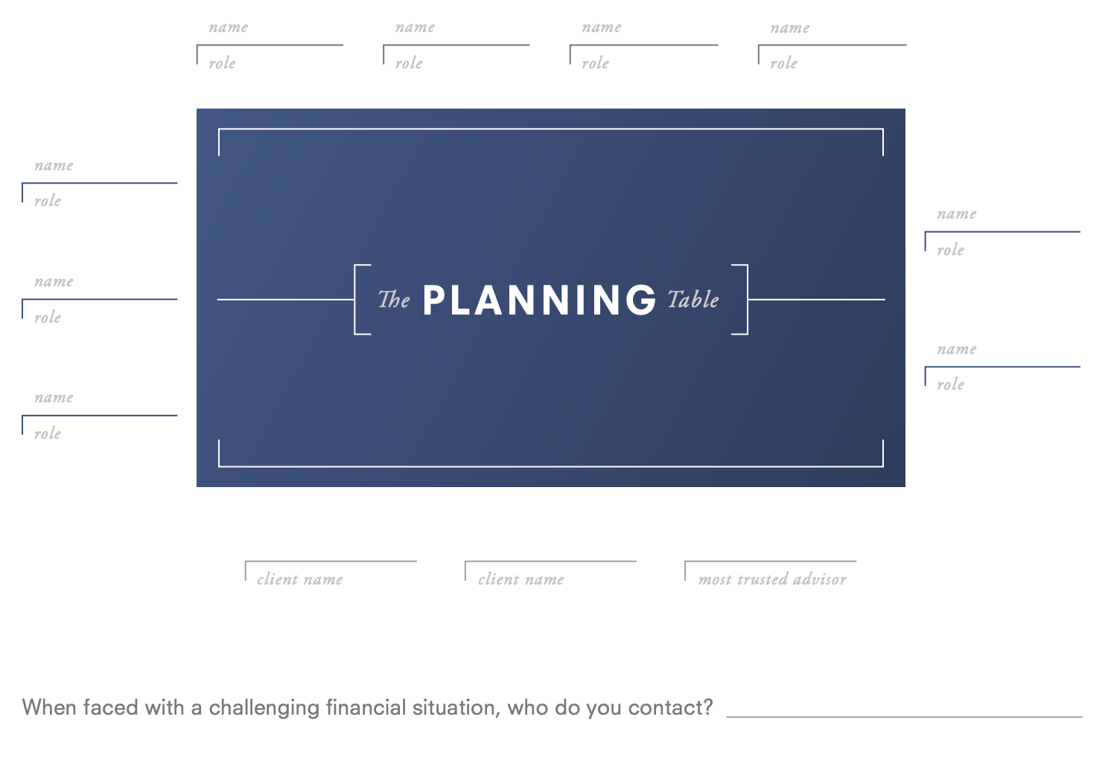
When faced with a challenging financial situation, who do you contact? (Possible MTA)
Document responsibility (What do they do?)
Identify the referral source and connect the relationships (How did they get on the team?)

Slide 14
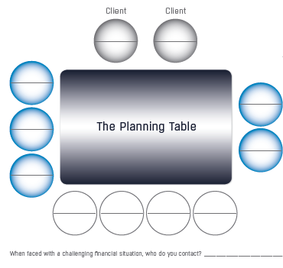
SOME THINGS TO CONSIDER...
STEP 1
Think about your best client relationship today
STEP 2
Put the client’s current advisors in the seats you believe the client has them in, including yourself
STEP 3
Look for insights. What do you see?
Notes:
To change the image behind the Mock up.
Select the layer - > Right Click -> Send to Back -> Delete the image -> Drag & Drop your Own Picture -> Send to Back (again)

Slide 15

WHAT’S
IMPORTANT
NEXT…
Our next call will focus on Values and Vision.
In advance of this call, please complete the following prep-work:
1. Login to the Members site and click on Courses. Complete Modules 5 and 6.
2. Go through the Values exercise firsthand on yourself (or consider including your spouse or partner, if applicable) to discover your top 5 core values. Be prepared to talk about your experience of going through the exercise, how you envision using it with clients, and to share a core value of yours that came out of the process.
3. Go through the Vision process using the questions covered in the lesson, thinking about your own planning. Think about how powerful it would be to have a clear vision defining what your clients really want and why it’s important to them. Be prepared to talk about your experiences.
Next Call: MAY 8 at 2PM EASTERN

