Slide 1
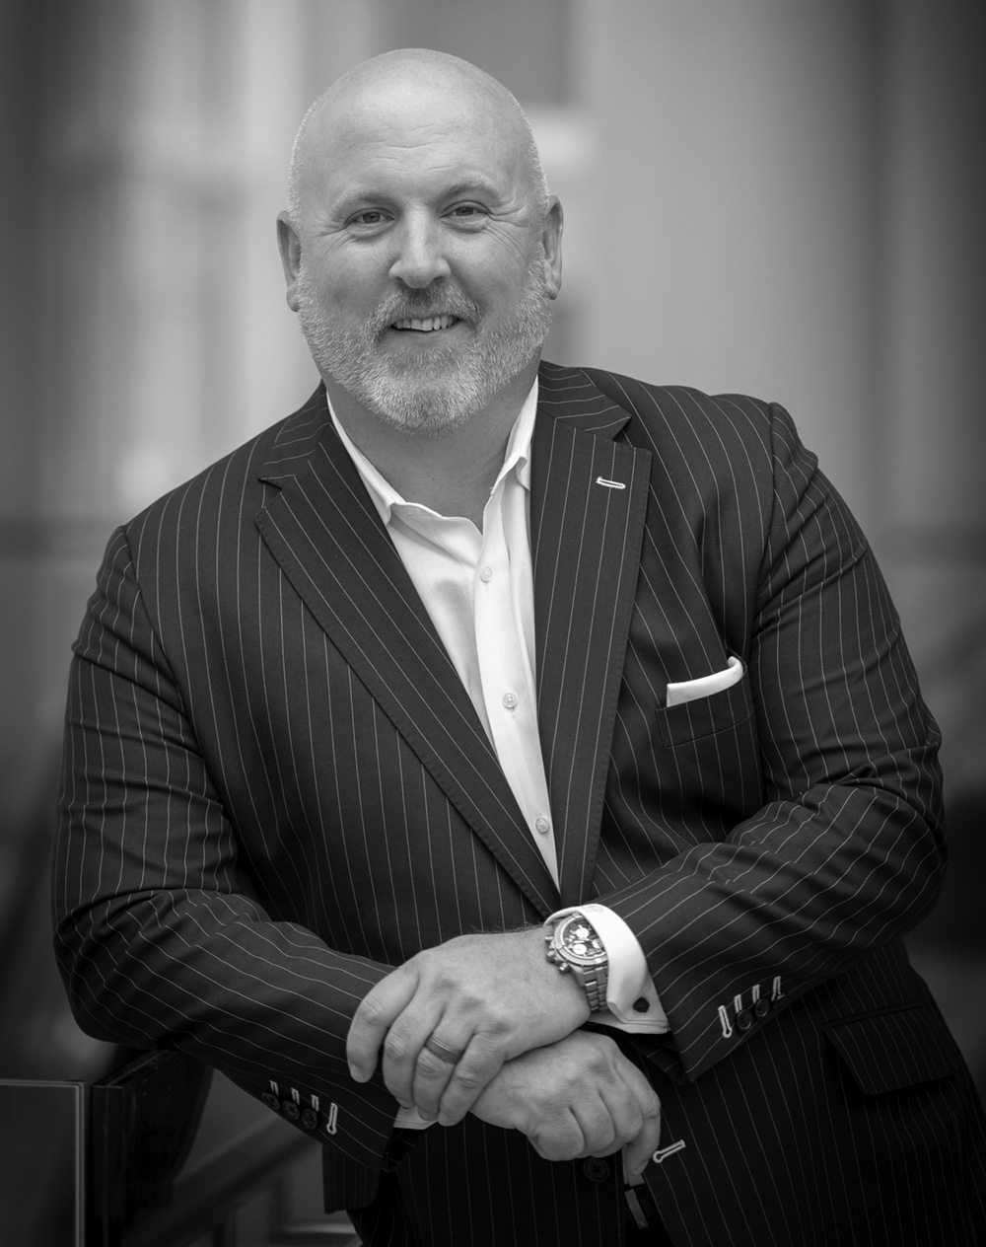
Integrating Fee Planning Into Your Practice
Handling Fee Objections and Next Steps
Todd Fithian
Co-Founder & CEO

Slide 2
WE START HERE
TODAY’S MEETING PLAN
CONTENT
PROBLEM
ACTION
If you follow the process and get at your clients WHY, then it would be rare to hear any objections.
There are some common roadblocks that advisors have in their heads when charging a fee.
We’ll go over these roadblocks and some questions you might hear and how to handle them.

Slide 3
LET’S OPEN IT UP...
What are some objections you think you might hear when introducing fee-planning?

Slide 4
6 COMMON CONCERNS
What many advisors think they will hear...
I’ve never had to pay a fee in the past.
My other advisors don't charge a fee.
This seems like a time-consuming process. How long will it take?
Don’t you already get paid a commission?
Your fee is too high.
What do I actually get for the fee?

Slide 5

1. The Mindset of a Fee-Based Financial Planner
Perceptions advisors need to address as they incorporate fees into their practice.
2. The Benefits of Charging Fees
Why you should charge fees and the positive impact it has on the client relationship.
3. How to Ask for the Fee with Existing Clients
Learn from your peers who have done it successfully.
4. How to Ask for the Fee with New Clients
A proven approach to introduce fees to new clients, along with the scripts that go with it.
5. How to Handle Objections
A process to explain the value clients will receive, and objections you may face with fool-proof responses.
6. How to Incorporate Fees with Joint Work Partners
Help your joint work partners gain opportunities they would not have had.
7. The Role of Thought
One of the biggest challenges an advisor faces in charging a fee is themselves. Psychologist George Pransky, PhD provides tips to overcome this.
8. How to calculate the fee
The formula to determine the fee you should charge to measure the true value of your plan.
WHITEPAPER OVERVIEW

Slide 6




TO THE POINT
WHY IT’S RARE TO HEAR ANY OBJECTIONS
YOU’RE PREPARED
YOU HAVE A STRUCTURE
You never ”wing it” with prospects
You follow the Approach Talk Structure
THE PLANNING HORIZON®
& THE WEALTH OPTIMIZATION SYSYTEM™
YOU’VE PRACTICED
So you don’t have to think about it
You’re talking about their WHY.

Slide 7

DEMONSTRATE YOUR DEFINABLE DIFFERENCE
THE PLANNING HORIZON®
The cornerstone conversation that shifts the relationship.
VALUES, VISION & GOALS
WHAT matters most to you, and WHY it’s important.
ABOVE
BELOW
STRATEGIES, TACTICS & TOOLS
HOW, WHO and WHEN to solve it.

Slide 8
Wealth Optimization System™
VALUES, VISION & GOALS
WHAT matters most to you, and WHY it’s important.
CONFIDENCE
Results Management Leading to Confidence
4
1
CLARITY
Discovery Leading to Clarity
Sustain
The Result
Identify Values,
Vision & Goals
3
2
Implement
The Solution
Think About
The Solution
RESULTS
Strategy Deployment Leading to Results
DECISIONS
Creative Solutions Leading to Decisions
STRATEGIES, TACTICS & TOOLS
WHO, HOW and WHEN to solve it.
V1.0

Slide 9
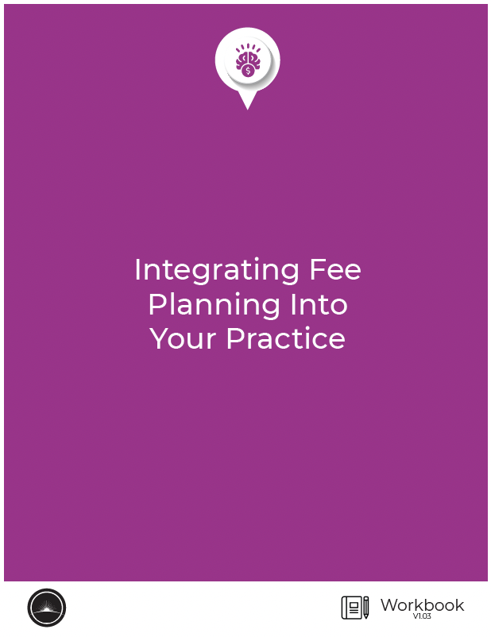
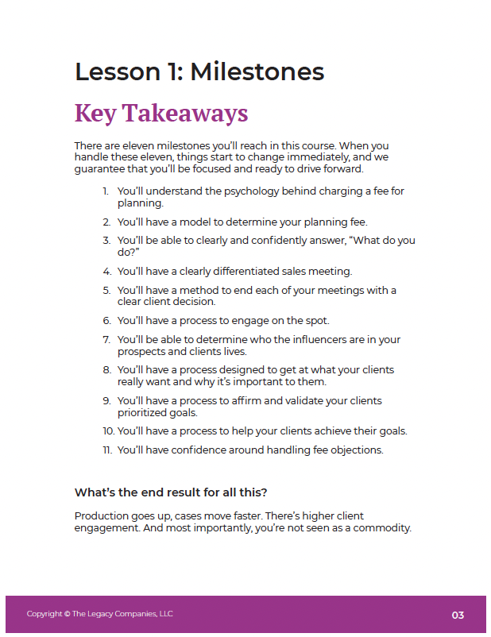
GO THROUGH THE WORKBOOK
If you haven’t done so already

Slide 10

CHECKING IN…
QUESTIONS?
What did you need to clarify or understand better?
Notes:
Words matter
Agenda is a loaded word
Plans are better
Use this with advisors

Slide 11

WHAT’S
IMPORTANT
NEXT…
To schedule your 1:1 call, please reach out to Mike at: michael@think-legacy.com
Let us know of any challenges or successes that you’ve had.
We’re always looking to improve, so please let us know if you have any feedback on the program.
Notes:
You’ll be receiving an invitation from your DVP to attend small group calls where you can talk about any successes and challenges with your peers.

