Slide 1

THE LEGACY QUESTIONNAIRE™ & THE LEGACY FAMILY QUESTIONNAIRE™
Todd Fithian
Co-Founder & CEO

Slide 2
MEETING PLAN
CONTEXT
PROBLEM
ACTION
Understanding how your clients feel about their wealth, as well as including the next generation in planning, are both critical for a successful practice.
Knowing where to start and how to go about it are two of the biggest challenges.
Our two industry-leading Questionnaires were designed to help you with these critical conversations.
Notes:
Oriented to how we’ll be working together
You have learning to do in IGNITE
But you’ll also be teaching it to advisors, and having some coach-style conversations with them to help them act on it.
This call is going to orient you to how we teach – what that process looks like – and our Growth Coach Approach.
Then we’ll set next steps together in preparation for next week.

Slide 3
THE LEGACY
QUESTIONNAIRE™
THE LEGACY
FAMILY
QUESTIONNAIRE™
THE TOOLS
The Legacy Questionnaire™ was designed to help you uncover your clients attitudes towards their wealth.
The Legacy Family Questionnaire™ was designed to get the next generation involved in the planning process.

Slide 4

THE LEGACY QUESTIONNAIRE™
Discovering values, attitudes and preferences related to:
Financial Independence
Family Legacy
Social Capital Legacy
1
3
2
Notes:
To change the image behind the Mock up.
Select the layer - > Right Click -> Send to Back -> Delete the image -> Drag & Drop your Own Picture -> Send to Back (again)

Slide 5
BENEFIT TO THE ADVISOR
4. | There are various perspectives regarding whether to discuss family financial resources with children or other heirs. Check the statement that most closely reflects your view.
Awareness to how much communication is happening within the family today.

Slide 6
BENEFIT TO THE ADVISOR
6. | You may be concerned that your children lack the necessary skills to manage wealth. Which statement most closely reflects your view?
Awareness to the parents view of their children's preparedness and what they’re prepared to do about it.

Slide 7

THE LEGACY FAMILY
QUESTIONNAIRE™
Discovering the expectations and the role that heirs want to play in their parents plan.
People and Events of Significance
Inheritance and Gifts
Social Capital Legacy
1
3
2
Notes:
To change the image behind the Mock up.
Select the layer - > Right Click -> Send to Back -> Delete the image -> Drag & Drop your Own Picture -> Send to Back (again)

Slide 8
BENEFIT TO THE ADVISOR
7. | How have your parents prepared you for financial inheritance?
Awareness of how money has been communicated within the family.

Slide 9
BENEFIT TO THE ADVISOR
Awareness of the expectations and timing of inheritance
10. | How much do you expect to receive in gifts/inheritance and when?
BENEFIT TO THE PARENT(S)
Clarity around the expectations of family members

Slide 10
BENEFIT TO THE ADVISOR
16. | Which changes in the world would you most like to help bring about with your philanthropy?
Knowing the causes, organizations and/or movements that are important to them is critical for connection

Slide 11
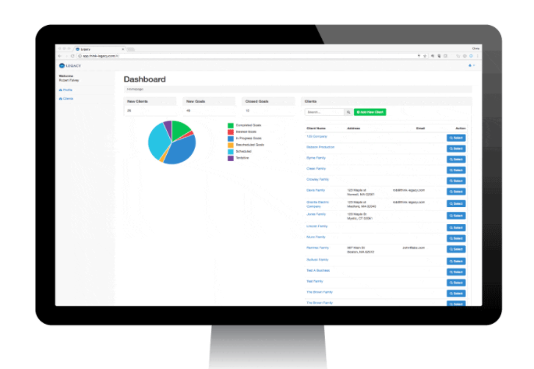
Work Like a Genius, with Qualitate™
Qualitate™ allows you to document the client conversations that matter, create differentiating deliverables, and allow decisions to move faster
Profile Report
Individual Affirmation Report
Differences Report
Comparison Report
Family Financial Philosophy

Slide 12

What do you need to clarify or understand better?
CHECKING IN…
QUESTIONS
Notes:
Words matter
Agenda is a loaded word
Plans are better
Use this with advisors

Slide 13

When and how do you plan to use The Legacy Questionnaire™ and The Legacy Family Questionnaire™?
What types of clients do you plan to implement it with first?
What are some of the benefits that you can see from using it?

Slide 14

WHAT’S
IMPORTANT
NEXT…
HERE’S WHAT TO DO
Next Call Topic: Managing, Running or Outsourcing Family Meetings
In advance of this call, please complete the following prep-work:
Complete Module 6 in the course
Come prepared to discuss your insights on the call
CALL DATE: WEDNESDAY, NOVEMBER 8 AT 1PM EASTERN

