Slide 1
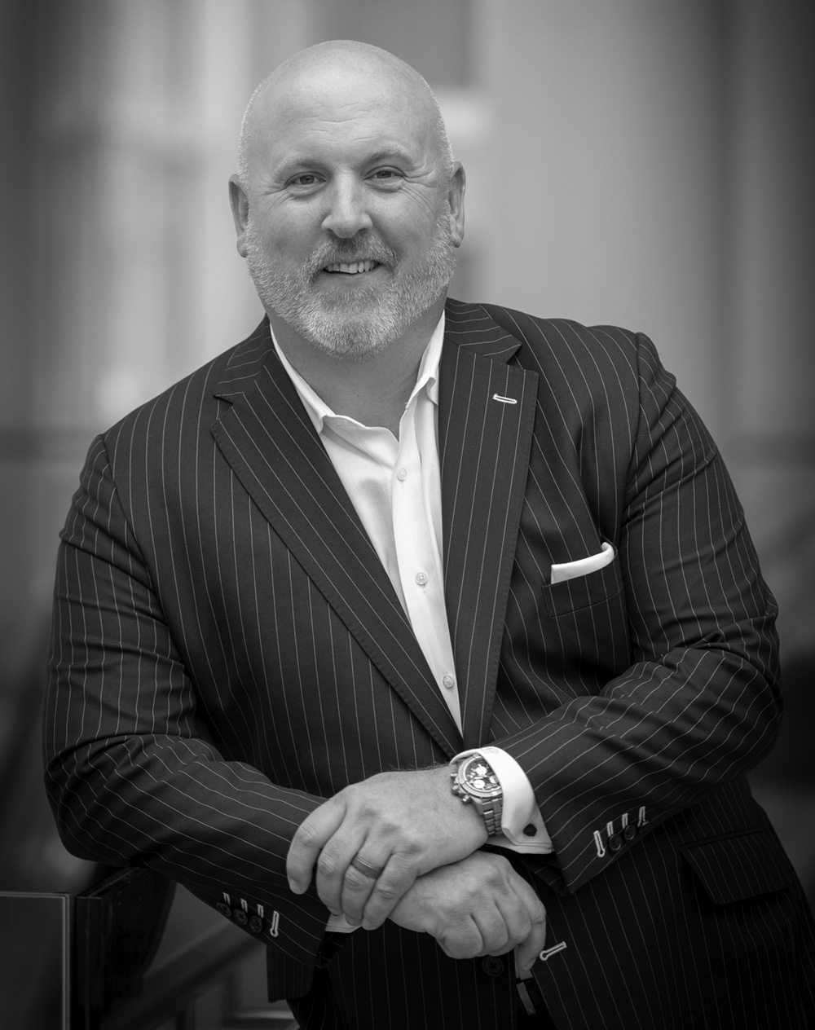
Generational Wealth Transfer Today
Todd Fithian
Co-Founder & CEO
Notes:
We help advisors grow their business and we’re glad we’re here
Introduce our team
This is about you winning
You are consultants helping advisors be successful, not wholesalers flogging product. We know there’s no question about that in your mind, and we want to make sure that there’s no question in anyone else’s mind too.

Slide 2
TODAY’S MEETING PLAN
CONTEXT
PROBLEM
ACTION
There’s a big opportunity to help families successfully plan across generations.
Statistically speaking, it has not gone well.
The Legacy Generational Wealth System™ and supporting tools will enhance your success and credibility.
Notes:
Oriented to how we’ll be working together
You have learning to do in IGNITE
But you’ll also be teaching it to advisors, and having some coach-style conversations with them to help them act on it.
This call is going to orient you to how we teach – what that process looks like – and our Growth Coach Approach.
Then we’ll set next steps together in preparation for next week.

Slide 3
Poll Question
What’s your greatest challenge as it relates to your generational wealth strategy today?
Notes:
No Process
Not sure where or how to begin
Aging population of clients
Time
Other

Slide 4

There has likely never been a greater opportunity than today where people are more connected with their own mortality.

Slide 5
Expected Services: Estate & Tax Planning, Education, Healthcare Planning, Family Planning, Philanthropy
Source: Spectrum Defining Wealth Management Report

Slide 6
90%
Percentage of heirs that change advisors promptly after receiving their inheritance.
Notes:
This is a major problem not only for advisors dependent on these assets but on the overall relationship. Its also a major change for the families because it often leads to a disconnect from the families vision, values and goals for the wealth. What’s worse is these numbers have not improved.

Slide 7
70%
Percentage of widows that change advisors in the months following their husband’s death.
Notes:
This boils down to communication, preparedness of heirs to receive the wealth and overall mis-alignment in planning.

Slide 8
72%
Percentage of millennials that said their parents’ advisors have never attempted to provide them financial advice.
Notes:
This boils down to communication, preparedness of heirs to receive the wealth and overall mis-alignment in planning.

Slide 9
70%
Percentage of heir families that lose their assets and family cohesion after receiving their inheritance.
Notes:
This boils down to communication, preparedness of heirs to receive the wealth and overall mis-alignment in planning.

Slide 10
50%
Percentage of advisors who do not meet with anyone beyond a spouse in a family.
Notes:
This boils down to communication, preparedness of heirs to receive the wealth and overall mis-alignment in planning.

Slide 11
“My client died, and I can’t get his spouse to return my call and she just received a check for $3 Million dollars. What should I do?”
Families are sustainable. Individuals are not.

Slide 12
Business owners often define Advisor relationships based on the products they sell which can put you at risk when the liquidity event happens.

Slide 13

Engaging the Client
Bubble
Engaging the client bubble

Slide 14
The successful transfer of wealth
across generations is as low as 30%.

Slide 15
Communication Gap
Parents
Kids
Advisors
Advisors
Advisors
Kids
Parents
Parents
Kids
Advisors

Slide 16
No Value, Negative Multiple
In the last two years I have seen 3 advisory businesses fail sell
as a result of little to no generational reach and an aging client base

Slide 17
The Trajectory of Planning
Financial
Planning
Estate/Business
Planning
Legacy
Planning
Generational
Wealth
Planning

Slide 18

The earlier you share your depth and breadth of services, the better.

Slide 19
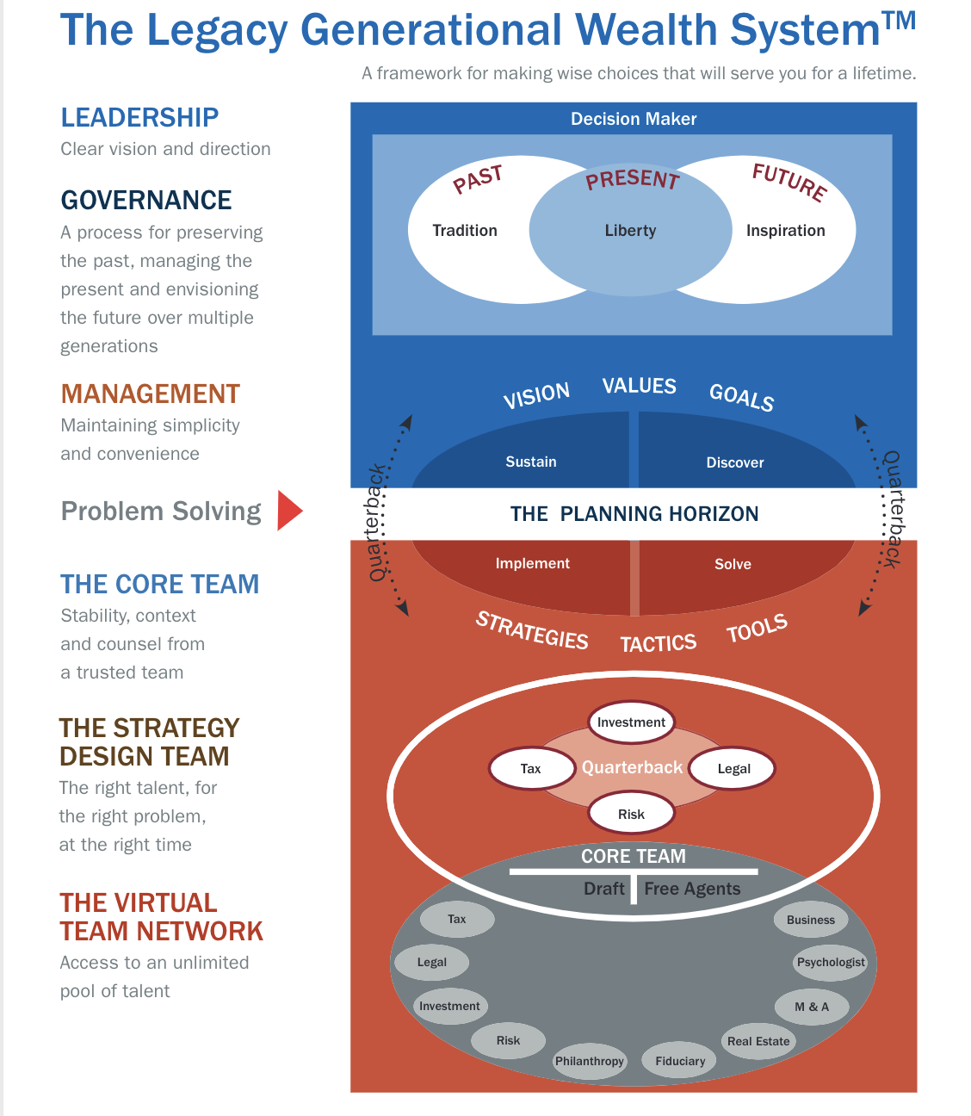
THE LEGACY GENERATIONAL WEALTH SYSTEM™
A framework for making wise choices that will serve you for a lifetime.

Slide 20
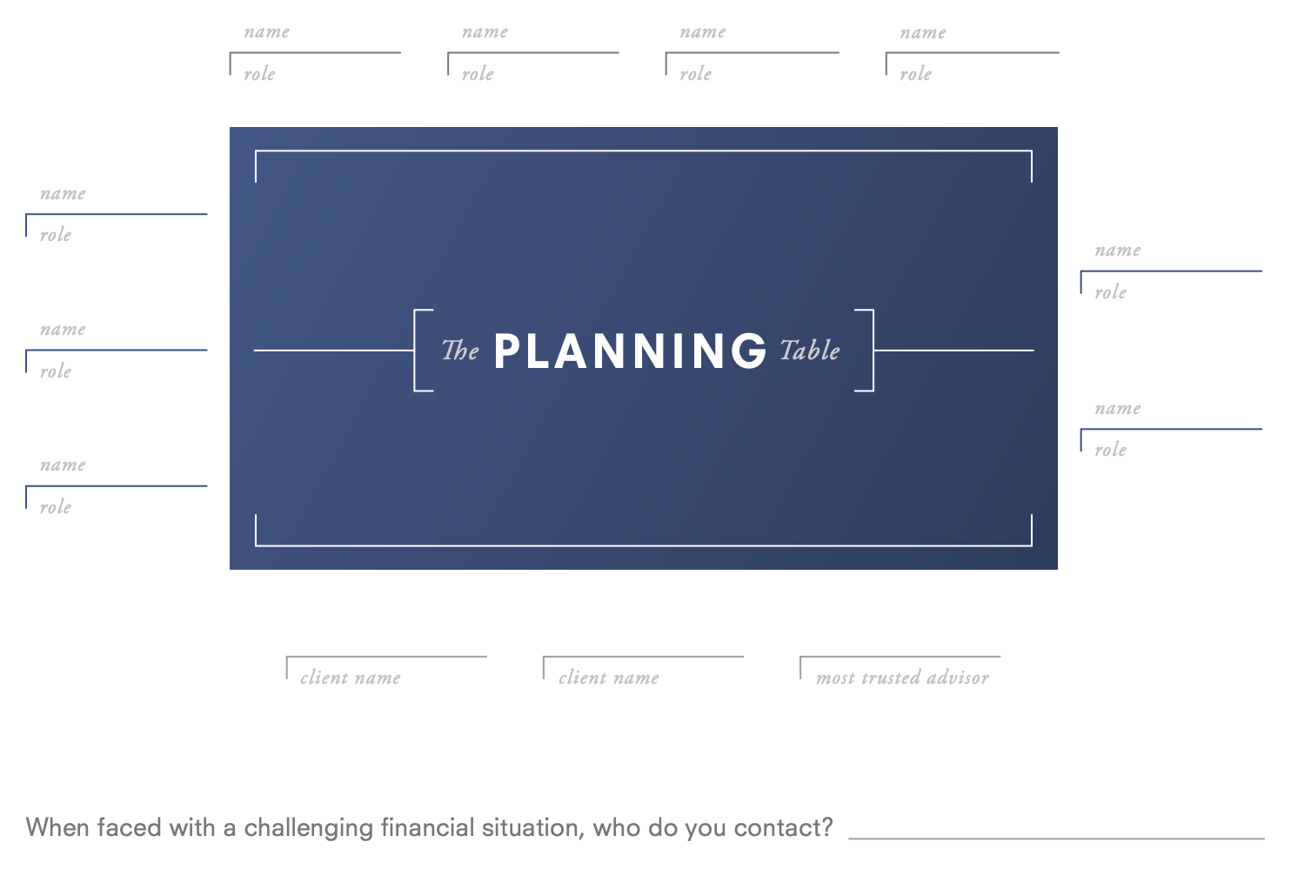
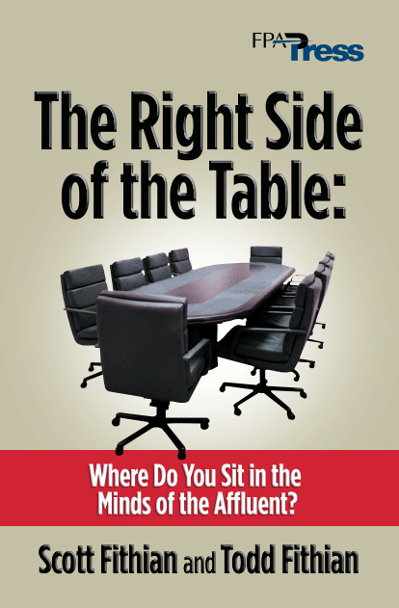
Strategies designed to help advisors get on their client’s side of the table, ultimately becoming the most trusted.
MTA
Most
Trusted
Advisor

Slide 21
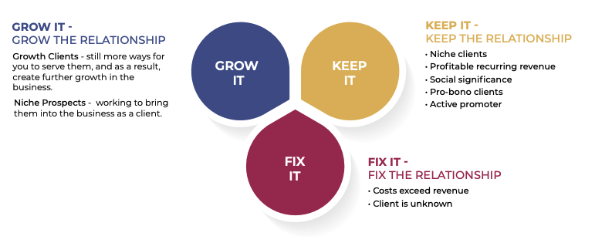
The Evolution of Segmentation: Client Clustering
The goal is to create profitable growth and purposeful retention of clients

Slide 22
“At the end of the day, people won't remember what you said or did, they will remember how you made them feel.”
-Maya Angelou

Slide 23

WHAT’S
IMPORTANT
NEXT…
Next Call Topic: The Legacy Generational Wealth System
In advance of this call, please complete the following prep-work so we can have a good dialogue around it:
Complete Module 3 in the course
Come prepared to discuss your insights on the call
NEXT CALL: OCTOBER 25 AT 1PM EASTERN

