Slide 1
THE
IMMERSION
PROGRAM
Call #5: Goals

Slide 2
WE START HERE
TODAY’S MEETING PLAN
CONTEXT
PROBLEM
ACTION
Discussing goals and objectives is table stakes for advisors, however there is a more powerful way to get at goals.
According to a recent study,* only 49% of clients believe that their Advisors recommendations are based on their personal goals, needs and priorities.
The GISOR™ Model ensures your clients see how their Goals connect to their Vision and to your recommendations.
*PRNewswire “Research Reveals Major Shifts in Communication and Trust Between Financial Planners and Their Clients” - February 2022
Notes:
Oriented to how we’ll be working together
You have learning to do in IGNITE
But you’ll also be teaching it to advisors, and having some coach-style conversations with them to help them act on it.
This call is going to orient you to how we teach – what that process looks like – and our Growth Coach Approach.
Then we’ll set next steps together in preparation for next week.

Slide 3
GOAL CLARITY
GOAL
AFFIRMATION
GOAL
ACHIEVEMENT
These are discussions designed to help your clients identify, prioritize, and take action on what is most important to them.

Slide 4
GETTING CLEAR ON
GOALS

Slide 5

There are 4 Decisions a wealth holder must make in order to work with you successfully:
  AGREE TO MEET
  AGREE TO ENGAGE
  COMMIT TO GOALS
  COMMIT TO IMPLEMENT
4 DECISION SYSYEM™
Because decisions are always better than meetings.

Slide 6

Informs
VALUES, VISION & GOALS
WHAT matters most to you, and WHY it’s important.
ABOVE
BELOW
STRATEGIES, TACTICS & TOOLS
HOW, WHO and WHEN to solve it.

Slide 7

DISCOVERY INSIGHT WORKBOOK
A very different kind of fact finder

Slide 8
STRUCTURE MATTERS
The Legacy GISOR Model™
The flow of the conversation highlights the client’s priority and readiness to take action.
G
S
O
R
GOAL
IMPORTANCE
SUPPORTING
RESOURCES
OBSTACLES
READINESS
Identify the top 3 prioritized goals.
Why is this goal important to accomplish?
What supporting resources will assist in accomplishing this goal?
What obstacles may prevent this goal from being accomplished?
What is your readiness on a scale of 1-5 in taking action today?

Slide 9
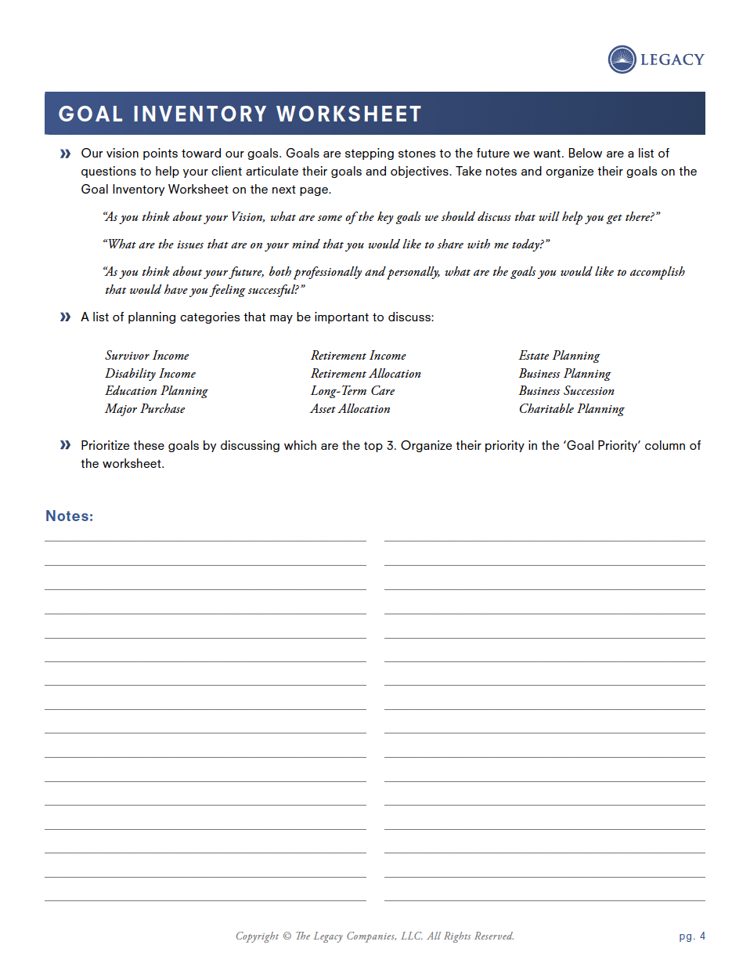
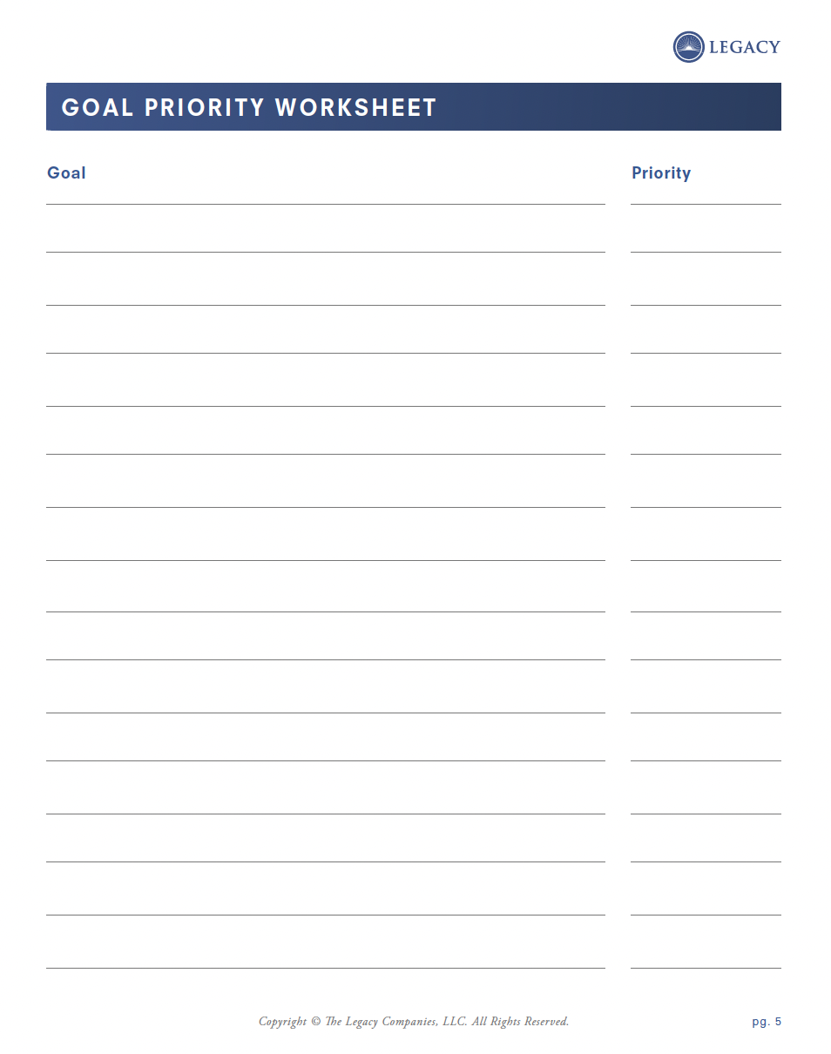
GOAL INVENTORY & GOAL PRIORITY WORKSHEET
To develop a good financial plan that is regularly monitored and updated
1
Now that we understand what you Value and you’ve clarified the Vision you want for the future, let’s get clear on the Goals that will move you closer to fulfilling your Vision.
Prioritize the top 3.
Pressure test the top 3 using the Goal Detail Worksheet.
We would like to fund our future grandchildren’s education as much as possible
3
To have an investment plan that enables us to reach out goals without taking more risk than necessary
2
To develop a good financial plan that is regularly monitored and updated
To pass as many of our assets onto our children and future grandchildren as possible.
4
We would like to fund our future grandchildren’s education as much as possible
To have an investment plan that enables us to reach out goals without taking more risk than necessary
To pass as many of our assets onto our children and future grandchildren as possible.
Notes:
To change the image behind the Mock up.
Select the layer - > Right Click -> Send to Back -> Delete the image -> Drag & Drop your Own Picture -> Send to Back (again)

Slide 10
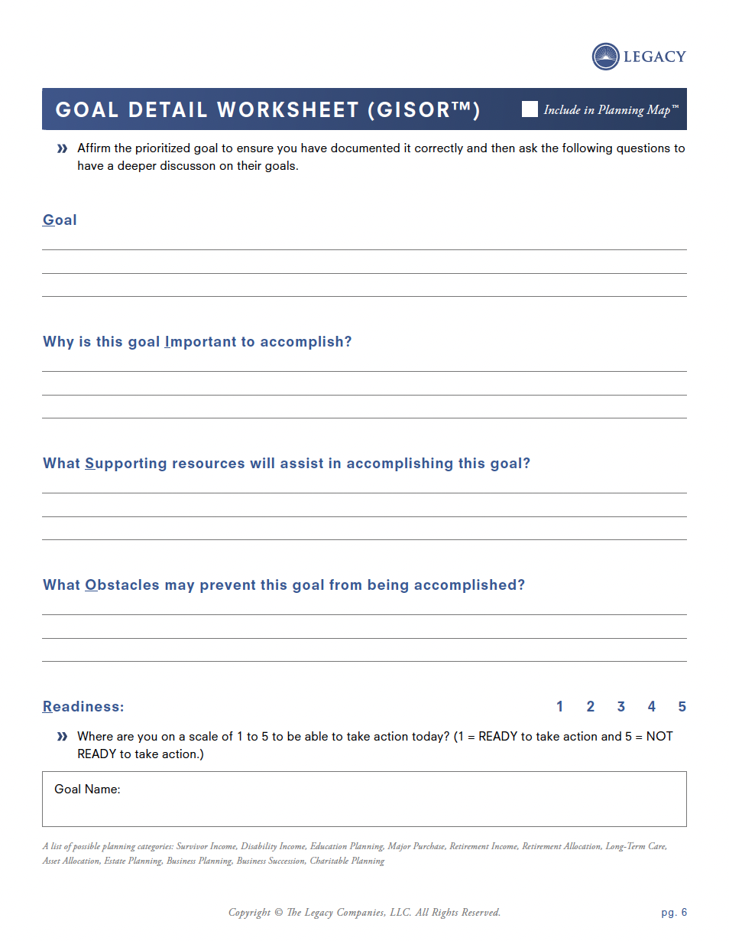
GOAL DETAIL WORKSHEET
To develop a good financial plan that is regularly monitored and updated
Affirm their top 3 prioritized goals, then go deeper.
IMPORTANCE
SUPPORTING RESOURCES
OBSTACLES
READINESS
We would be clear on where we are financially. Our parents never planned, and we didn’t like how it turned out. We need to know if we can do all the things we want to do for our children and grandchildren, while ensuring we have enough for ourselves
1
Joe has a very secure job and is earning his highest income ever. We have funded our retirement plans fully since day 1. The market is performing well. Joe is going to work for another 10 years. We are in good health.
3
2
The market might not perform. Joe could lose his job. Our health could get bad or one of us could even die. One of our kids could get sick or need other financial assistance.
1
Notes:
To change the image behind the Mock up.
Select the layer - > Right Click -> Send to Back -> Delete the image -> Drag & Drop your Own Picture -> Send to Back (again)

Slide 11
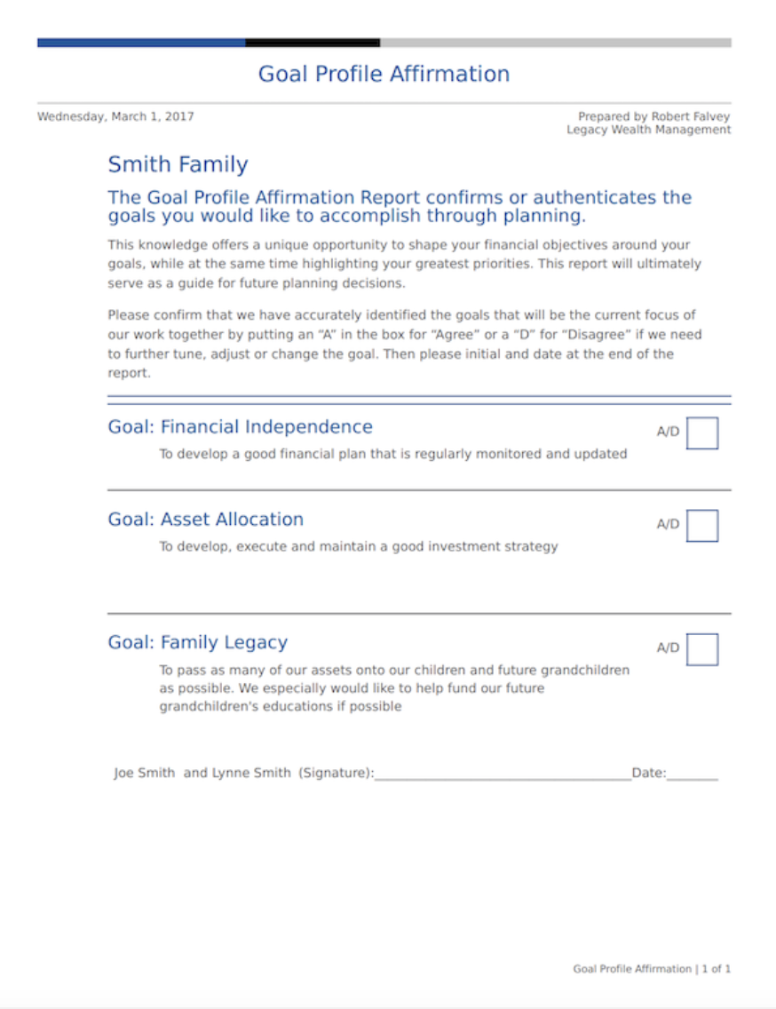
GOAL AFFIRMATION
The client affirms the goal and the priority
Agree/Disagree
Additional Comments
1
3
2
Notes:
To change the image behind the Mock up.
Select the layer - > Right Click -> Send to Back -> Delete the image -> Drag & Drop your Own Picture -> Send to Back (again)

Slide 12
GOAL ACHIEVEMENT™

Slide 13
There are 4 Decisions a wealth holder must make in order to work with you successfully:
  AGREE TO MEET
  AGREE TO ENGAGE
  COMMIT TO GOALS
  COMMIT TO IMPLEMENT
4 DECISION SYSYEM™
Because decisions are always better than meetings.

Slide 14
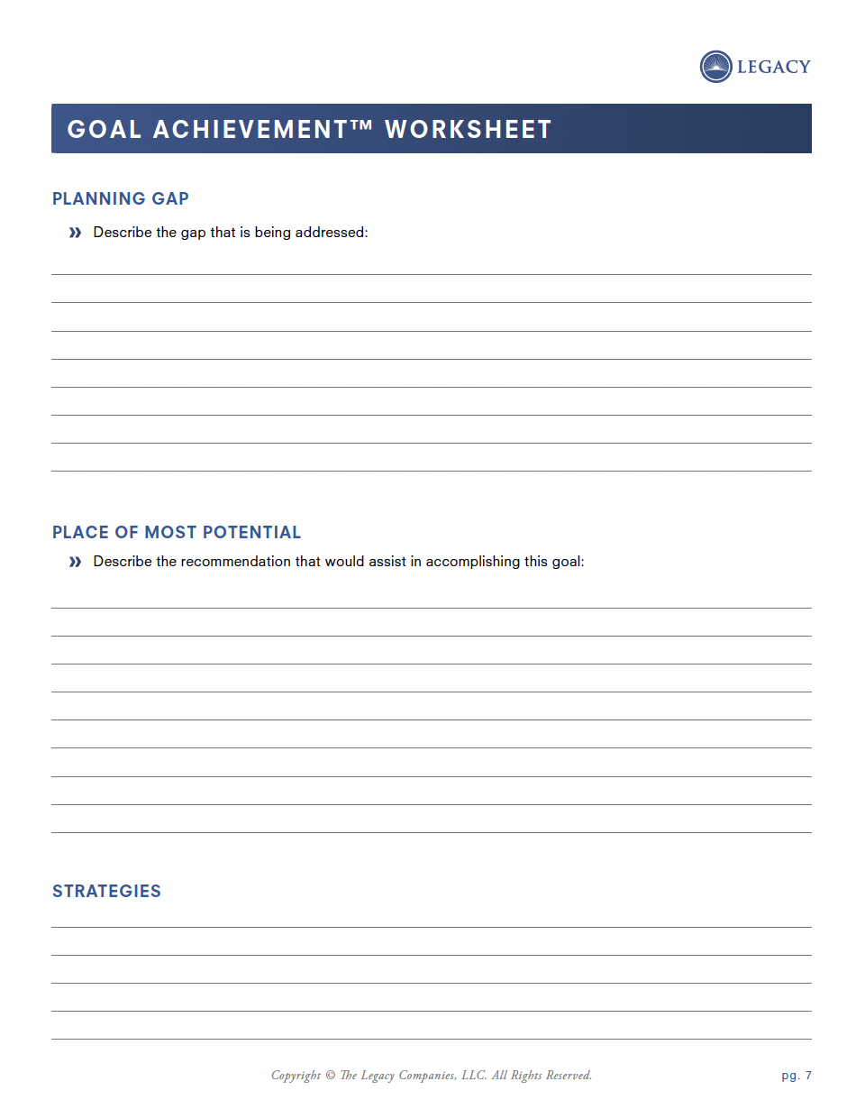
GOAL ACHIEVEMENT WORKSHEET
Planning Gap
Place of Most Potential (Recommendation)
Strategies
1
3
2
Notes:
To change the image behind the Mock up.
Select the layer - > Right Click -> Send to Back -> Delete the image -> Drag & Drop your Own Picture -> Send to Back (again)

Slide 15
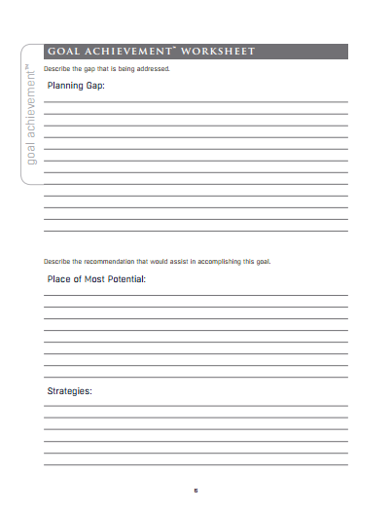
Joe and Lynne’s retirement plan strategies for saving and investing has not been updated in several years.
GOAL ACHIEVEMENT WORKSHEET
Planning Gap
Place of Most Potential (Recommendation)
Strategies
1
2
3
A retirement analysis needs to be completed taking into consideration Joe and Lynne’s desire to retire in 10 years, their current after-tax income objective and their tolerance levels for investing.
Notes:
To change the image behind the Mock up.
Select the layer - > Right Click -> Send to Back -> Delete the image -> Drag & Drop your Own Picture -> Send to Back (again)

Slide 16

CHECKING IN…
QUESTIONS?
What do you need to clarify or understand better?
Notes:
Words matter
Agenda is a loaded word
Plans are better
Use this with advisors

Slide 17

WHAT’S
IMPORTANT
NEXT…
  Next Call: December 17 @ 2PM Eastern
Topic: Action Plan
During this call, we’ll revisit the teachings to ensure you can get the results you’re after. We will also set a clear direction for the continued resources available, and how to access our team for support.
In advance of this call, please complete the following prep-work:
Complete the Action Plan (which will be sent out tomorrow via email)
Come prepared to share any questions, successes, or struggles you have had

