Slide 1
THE
IMMERSION
PROGRAM
Call #3: The Planning Table

Slide 2




THE BRIDGE TALK™
Create meaningful connections quickly, to achieve Decision 1: Agree to Meet
APPROACH TALK
A powerful first meeting to arrive at Decision 2: Agree to Engage
PLANNING TABLE
Understand who else is at the Planning Table and where you sit
Notes:
To change the image behind the Mock up.
Select the layer - > Right Click -> Send to Back -> Delete the image -> Drag & Drop your Own Picture -> Send to Back (again)

Slide 3
WE START HERE
TODAY’S MEETING PLAN
CONTEXT
PROBLEM
ACTION
Navigating the client’s other advisors is key to long term success
It’s not something we typically identify as preventing our growth
There is a better way to lead this discussion and win more
Notes:
Oriented to how we’ll be working together
You have learning to do in IGNITE
But you’ll also be teaching it to advisors, and having some coach-style conversations with them to help them act on it.
This call is going to orient you to how we teach – what that process looks like – and our Growth Coach Approach.
Then we’ll set next steps together in preparation for next week.

Slide 4



TO THE POINT
RAPID RECAP OF THE PLANNING TABLE
BE AWARE
LEADERSHIP
Are there opportunities being lost
Doing the things nobody else will
STRATEGY MATTERS
PERFECT PRACTICE
Discovering the relationship matrix
So you don’t have to think about it

Slide 5
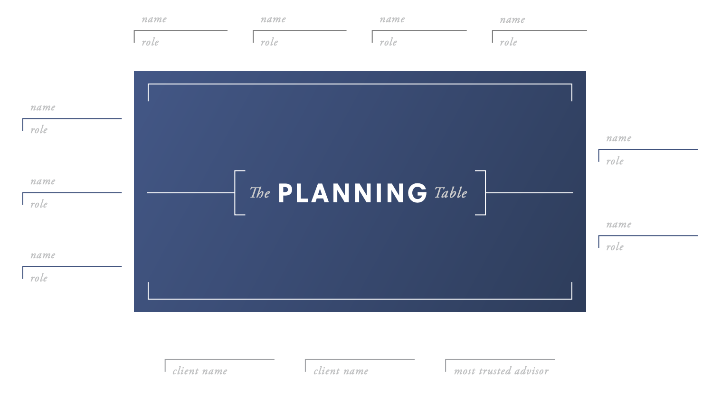

Slide 6
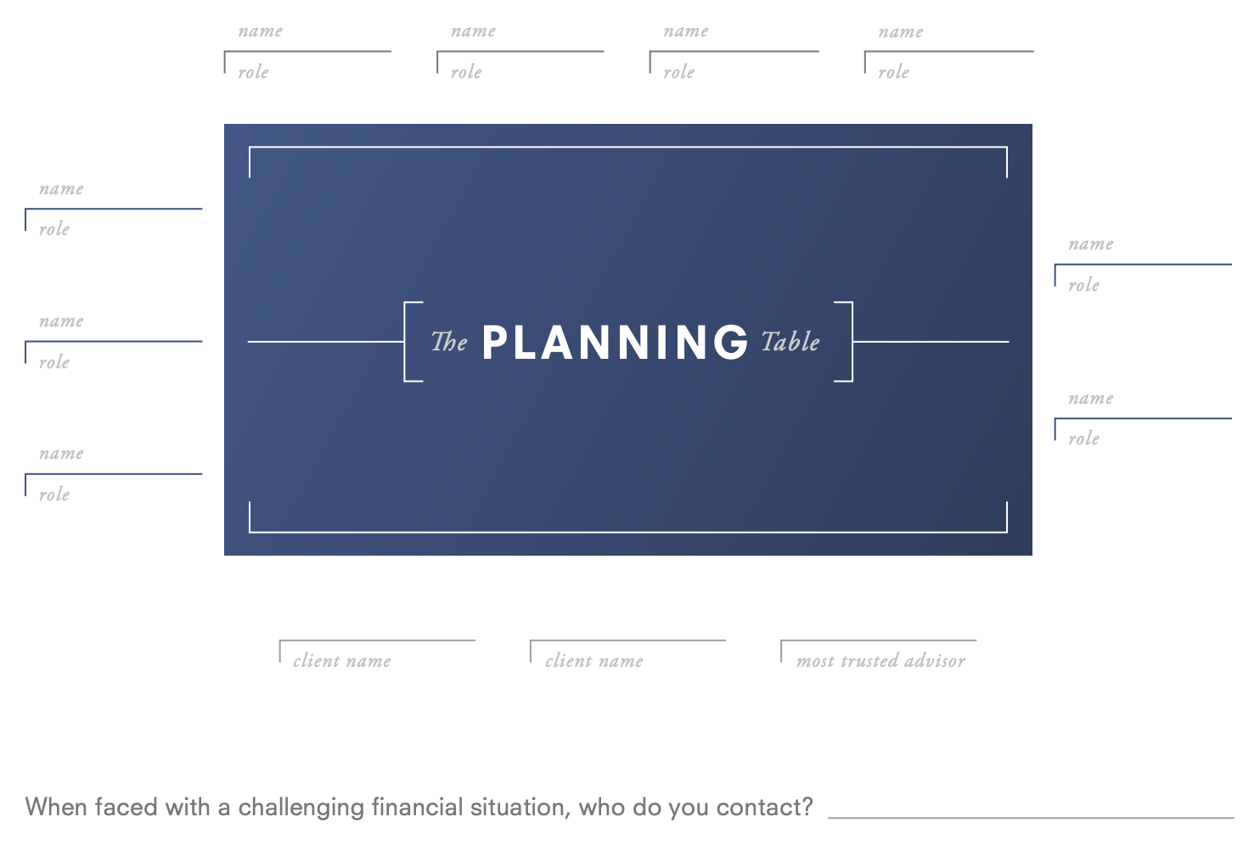
When faced with a challenging financial situation, who do you contact? (Possible MTA)
Document responsibility (What do they do?)
Identify the referral source and connect the relationships (How did they get on the team?)

Slide 7
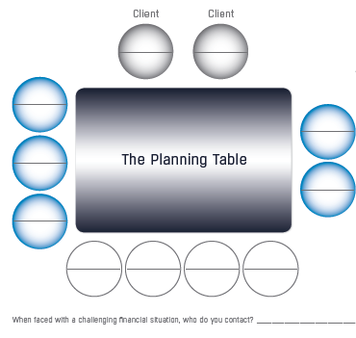
ACTIVITY
STEP 1
STEP 2
Have a blank planning table tool or draw it on a blank piece of paper
Think about your best client relationship today
STEP 3
STEP 4
Put the client’s current advisors in the seats you believe the client has them in, including yourself
Look for insights. What do you see?
Notes:
To change the image behind the Mock up.
Select the layer - > Right Click -> Send to Back -> Delete the image -> Drag & Drop your Own Picture -> Send to Back (again)

Slide 8

PERFECT PRACTICE
WHAT DID YOU LEARN?
Practice makes permanent. Perfect practice makes perfect.
What did you see that worked? What didn’t work? What did you learn? What will you do next?

Slide 9

CHECKING IN…
Questions are good when they lead to clarity.
What did you need to clarify or understand better?
QUESTIONS
Notes:
Words matter
Agenda is a loaded word
Plans are better
Use this with advisors

Slide 10

WHAT’S
IMPORTANT
NEXT…
Next Call: December 3 at 2PM Eastern
Topic: Creating Powerful Relationships: Qualitative Discovery – Values and Vision
In advance of this call, please complete the following prep-work:
1. Login to the Immersion course in the Members site and complete Modules 3 and 4.
2. Go through the Values exercise firsthand on yourself (or consider including your spouse or partner, if applicable) to discover your top 5 core values. Be prepared to talk about your experience of going through the exercise, how you envision using it with clients, and to share a core value of yours that came out of the process.
3. Go through the Vision process using the questions covered in the lesson, thinking about your own planning. Think about how powerful it would be to have a clear vision defining what your clients really want and why it’s important to them. Be prepared to talk about your experiences.

